Slide 1
ML Final Project:
Grade Prediction
0612019 鄧遠祥 0616093 吳柏憲 0616225 張承遠 0616227 陳亭妤 0616228 莊于萱

Slide 2
Introduction
01
05
Model Construction
-Logistic Regression
Data Pre-Processing
02
TABLE OF CONTENTS
06
Model Construction
-Random Forest
Data Visualization
03
Model Construction -CNN
04
07
Problems and Future Work
08
Conclusion

Slide 3
01
Introduction
You can enter here the subtitle if you need it

Slide 4
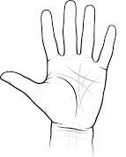
Introduction
Predict students’ grade using Machine Learning.
How to predict?
第幾類組
每周運動次數
對自己科系的喜歡程度

Slide 5
Motivation
Curious about whether fortune teller is a superstition or a true story.
Try to solve something that human is hard to recognize.

Slide 6
02
Data Pre-Processing
You can enter here the subtitle if you need it

Slide 7
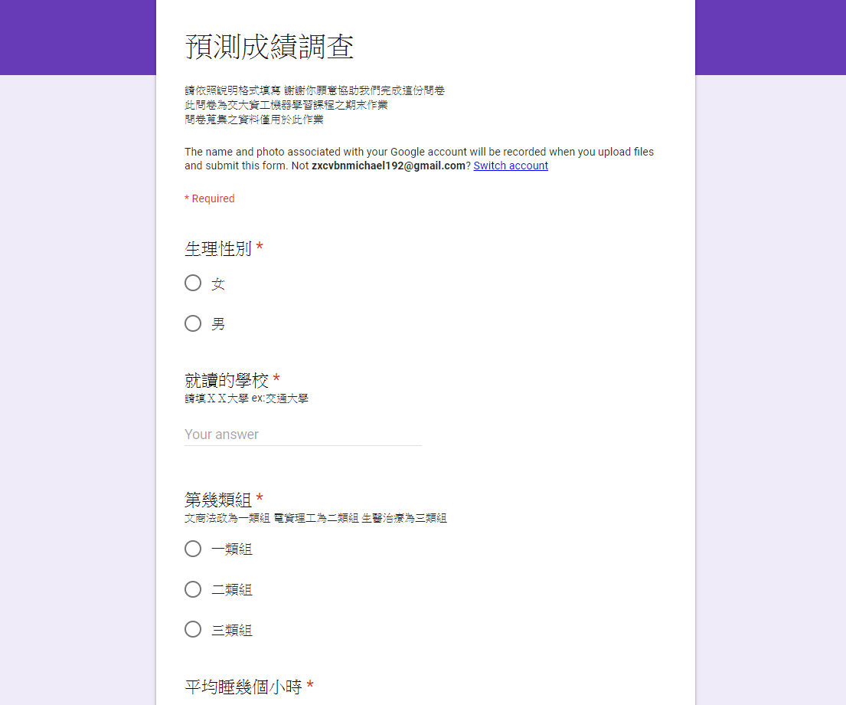
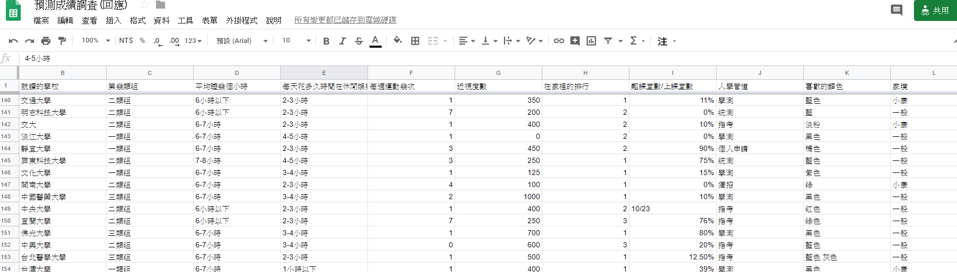
Data Collection
Got about 180 reponses.
Questionnaire posted on social media
with 17 questions.
(16 features and 1 picture)

Slide 8
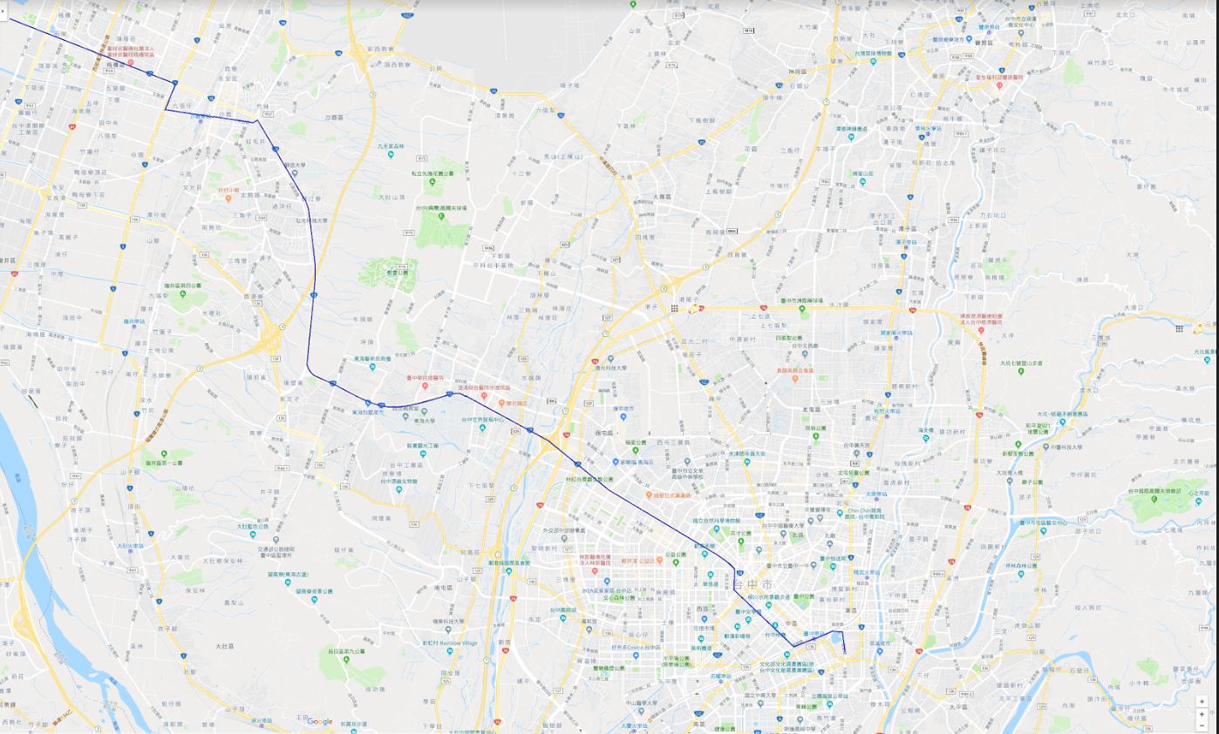
Data Processing
Fill missing value:
With highest frequency, if categorical feature.
With average number, if numerical feature.
Deal with noise data:
Some data are obviously noisy.
Ex: 就讀學校：鬼殺隊, 近視度數：3.1415 etc.
Ex: upload a GoogleMap picture instead of a palm picture.

Slide 9
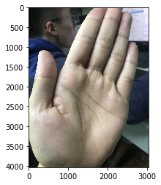
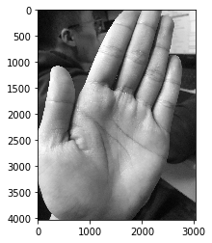
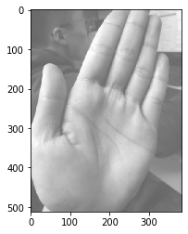
Data Preprocessing
For Images:
Resize image
Transform image
GrayScale
Gaussian Filter
For features:
Label encoding
One-hot encoding
Original (RGB)
GrayScale
Gaussian Filter
Reduce
Picture
Noise!

Slide 10
Data Preprocessing
88(50%)
44(25%)
45(25%)
For Image classification:
(CNN model)
Training Set
Validation Set
Testing Set

Slide 11
Data Preprocessing
123(75%)
53(25%)
For other models:
(RandomForest,
Logistic Regression)
Training Set
Validation Set

Slide 12
Data Augmentation
Translate, Rotate, Zoom picture to get more data

Slide 13
03
Data Visualization

Slide 14
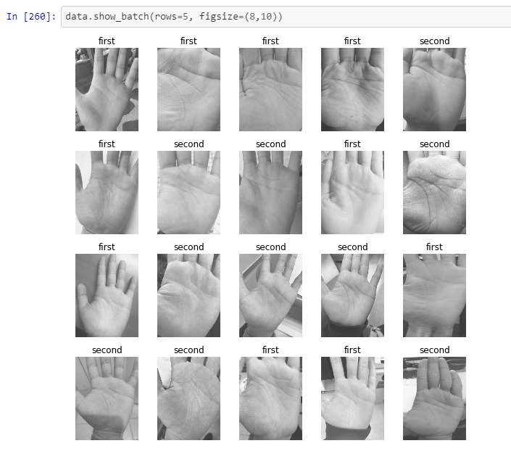
Image Visualization

Slide 15
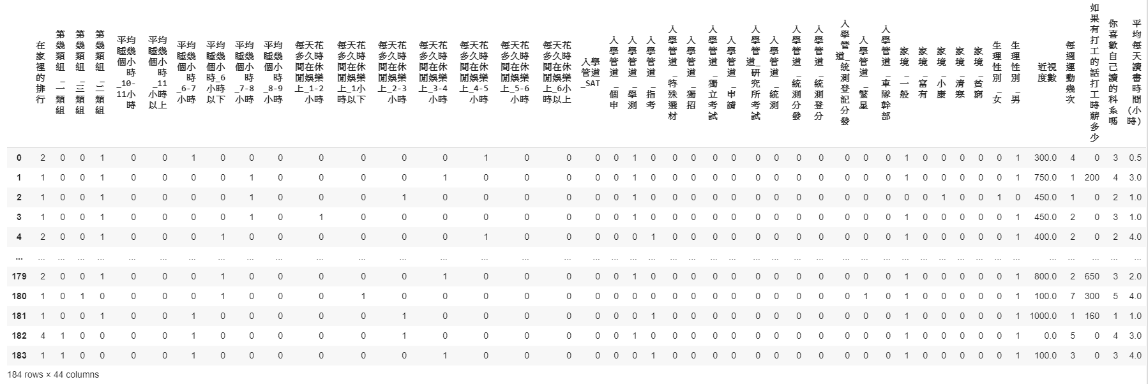
Data Visualization

Slide 16
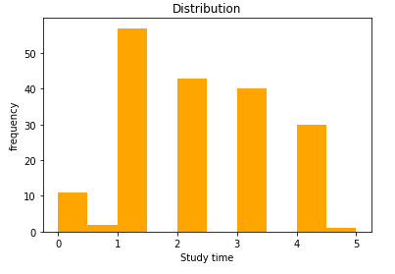
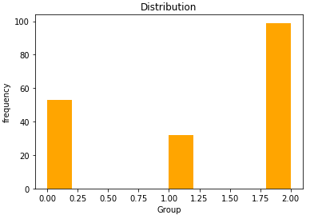
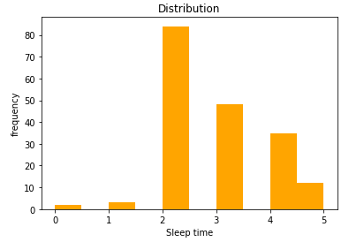
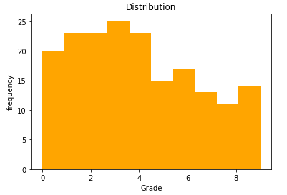
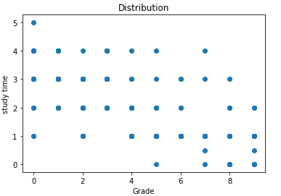
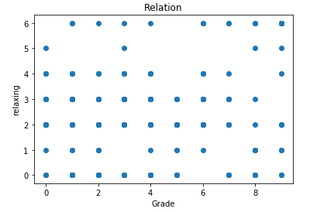
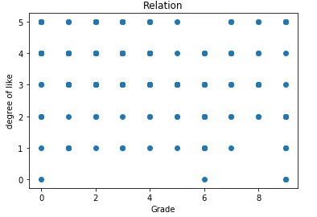
平均讀書時間(小時)
第幾類組
平均睡眠時間
平均成績%數
成績 & 讀書時間
成績 & 每天花多少時間休閒娛樂
成績 & 對自己科系喜歡程度

Slide 17
Analysis
Seems that there is no obvious relation between grade and features, so
We simply the question to predict whether the person’s grade is above 40%
Or under 40%.
Grade above 40%
Grade from 0~100%
Why 40%?
Grade below 40%
For Recommendation

Slide 18
04
Model Construction-CNN
You can enter here the subtitle if you need it

Slide 19

Convolutional Neural Network

Slide 20
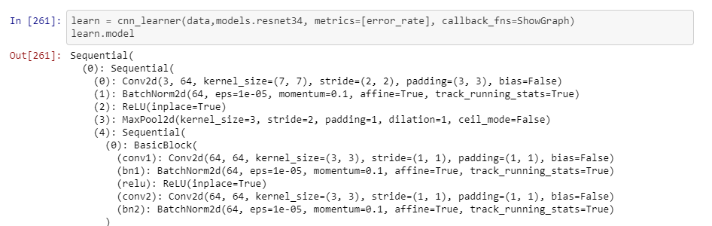
Pretrained CNN
Resnet34: A CNN model that have been pre-trained on ImageNet.
34 means layer
Other models like: VGG16, MobileNet…...
Transfer learning
Construct Model:

Slide 21
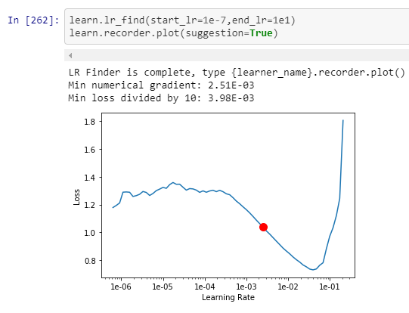
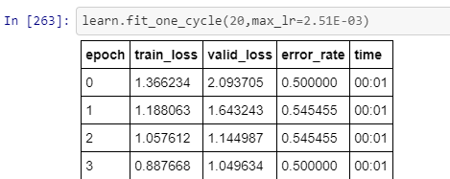
Using Fastai-
A deep learning library
Then use the appropriate learning rate to train model.
Use lr_find to find the appropriate learning rate.

Slide 22
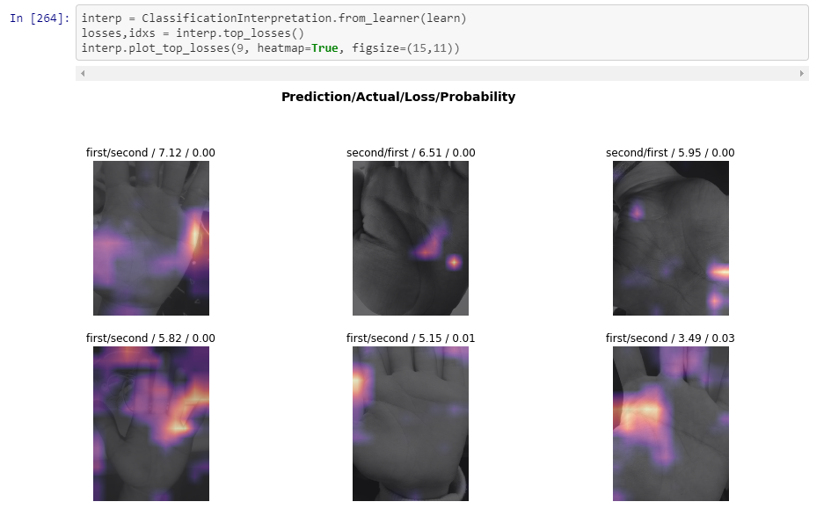
Top losses cases

Slide 23
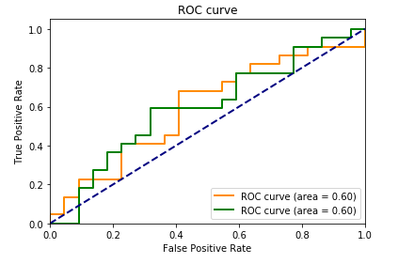
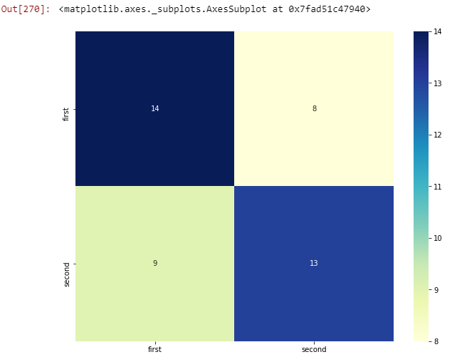
Results
First: grade above 40%
Second : grade under 40%
Actual
first
second
Got Accuracy: 60%
Predicted

Slide 24
05
Model Construction-
Logistic Regression

Slide 25
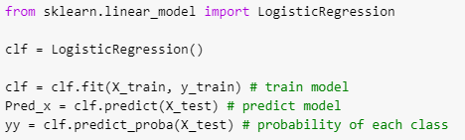
Logistic Regression
Using sklearn

Slide 26
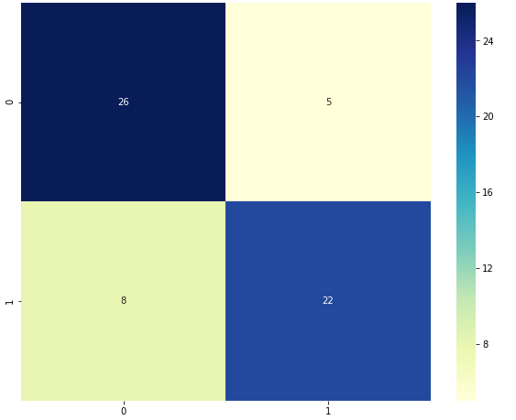
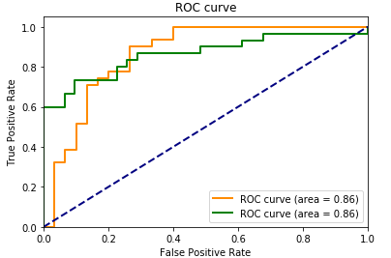
Result
0: grade above 40%
1 : grade under 40%
Actual
predicted
Precision of 0: 76%
Precision of 1: 81%
Sensitivity of 0: 83%
Sensitivity of 1: 73%
For holdout validation: Accuracy: 78%
For k-fold validation: Accuracy: 75%

Slide 27
06
Model Construction-
Random Forest

Slide 28
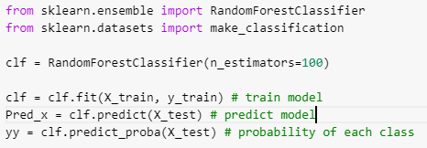
Random Forest
Using sklearn

Slide 29
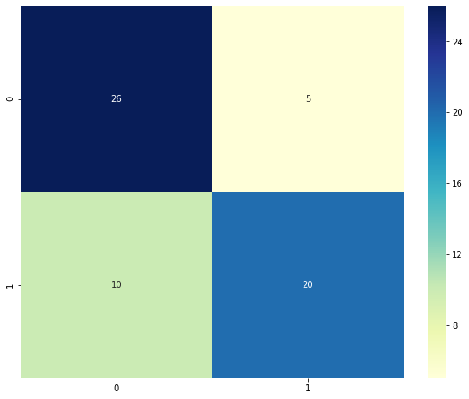
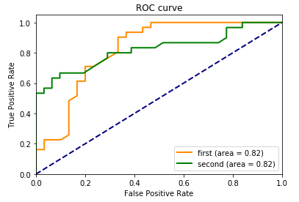
Results
0: grade above 40%
1 : grade under 40%
Actual
predicted
Precision of 0: 76%
Precision of 1: 80%
Sensitivity of 0: 81%
Sensitivity of 1: 72%
For holdout validation: Accuracy: 75%
For k-fold validation: Accuracy: 74%

Slide 30

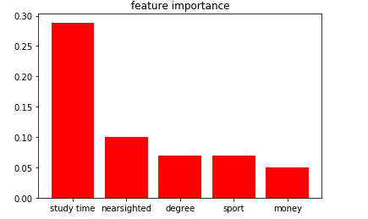
Analysis
Study time: 平日讀書時間
Nearsighted : 近視度數
Degree: 對自己科系的喜歡程度
Sport: 每周運動次數
Money: 打工時薪

Slide 31
07
Problems & Future Work
You can enter here the subtitle if you need it

Slide 32
Problems
For Image classification:
Resolution of image
Different Camera
Standard Rules
Dependency
Extraction of palm texture
For other data classification:
Features dependency
Design of Questionnaire
Problems in common:
Lack of sample data!

Slide 33
Future Work
Collecting more and more data
Try other suitable features
Try to use the same camera to take picture
Change a topic
(Maybe there’s no relation between palm and grade)

Slide 34
08
Conclusion
You can enter here the subtitle if you need it

Slide 35
Conclusion
Study time contributes the most in predicting grade
Logistic Regression performs better than Random Forest.
Palmistry seems unrelated but with this CNN model we can find the relations with the features.

Slide 36
THANKS
For
Listening

Slide 37
Q & A

